Slide 1
Lower Granite Dam Adult Chin Window Count (fish/day) vs Water Temperature (52’ deep forebay) for 20 APR – 7 JUN 2016

Slide 2
Lower Granite Dam Ladder Exit Test – Day 1 (first 24 hrs) Response
Average | Shower ON | Shower OFF
1030 to 1030 | 6/5/2016 | 6/6/2016
Trap | 60.43076 | 61.41671
TurnPool | 61.35462 | 61.68118
Diffuser | 62.62913 | 61.95598
Exit | 62.52031 | 61.86045
FBExitS | 62.9941 | 62.40244
FBExitN | 63.1809 | 61.80992
Differential | 1.165694 | 0.179268

Slide 3
Lower Granite Dam Ladder Travel Time (PIT detection time delta)
Summary TT (hours) | Shower | N | Min | Max | Average | Median
May 30 1038 to June 1 0638 | Off | 11 | 0.08 | 1.53 | 0.37 | 0.13
June 6 1038 to June 8 0638 | On | 21 | 0.07 | 0.42 | 0.16 | 0.11
Lower Granite Dam Ladder Exit Pool Residence Time (PIT detection time delta)
Summary TT (minutes) | Shower | N | Min | Max | Average | Median
May 30 1038 to June 1 0638 | Off | 118 | 0.1 | 30.0 | 4.9 | 3.4
June 6 1038 to June 8 0638 | On | 23 | 0.2 | 13.1 | 2.8 | 0.7

Slide 4
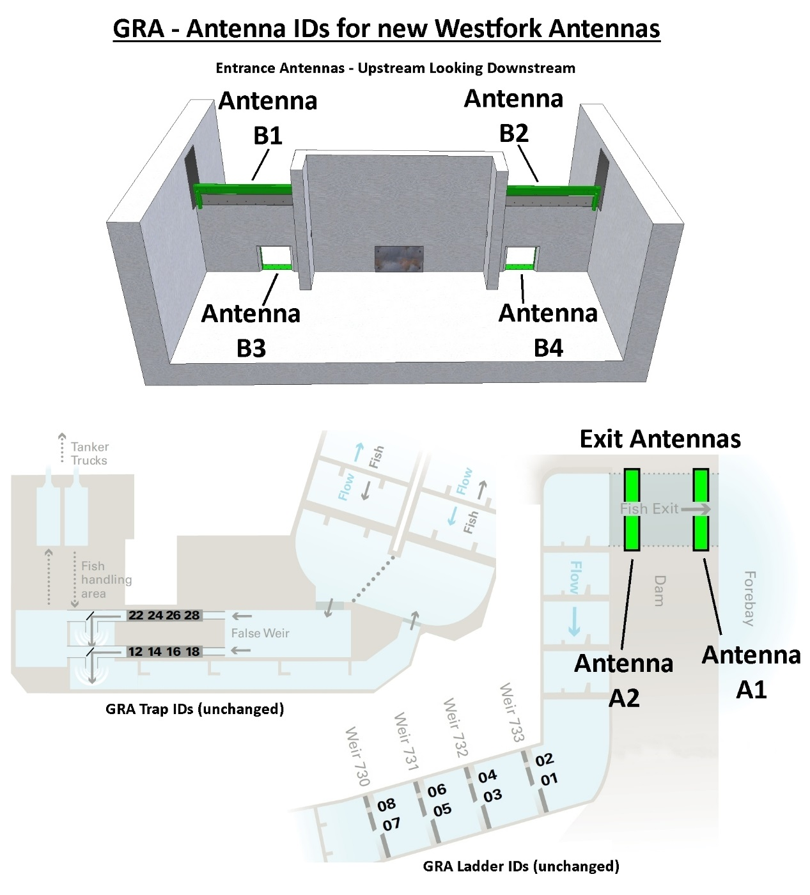
Lower Granite Dam PIT Antennae Coil Designations and Locations
 | Type | Antenna
Weir 730 | Slot | 1
Weir 731 | Slot | 3
Weir 732 | Slot | 5
Weir 733 | Slot | 7
Weir 730 | Orifice | 2
Weir 731 | Orifice | 4
Weir 732 | Orifice | 6
Weir 733 | Orifice | 8
Trap |  | 12
Trap |  | 14
Trap |  | 16
Trap |  | 18
Trap |  | 22
Trap |  | 24
Trap |  | 26
Trap |  | 28
Exit Pool top |  | A1
Exit Pool bottom |  | A2
Entrance orifice | Orifice | B3
Entrance orifice | Orifice | B4
Entrance weir | weir | B1
Entrance weir | weir | B2

